Slide 1
POWER SCRAPING MODULE
Team: SDMAY 20-10
Members: Shahzaib Shahid, Jordan Fox, Xiangyu Cao, Andesen Ande, Ahmed Salem, & Benjamin Yoko
Client: Honeywell
Faculty Advisor: Prof. Gary Tuttle
Website: https://sdmay20-10.sd.ece.iastate.edu/
Notes:
Shahzaib

Slide 2
Problem Statement
Research and development of a device that will efficiently collect, convert, and store low voltage energy.
The purpose is to provide an alternative self-powered source for devices.
The goal of this project is to take a small, unusable AC voltage as a source and convert it to a usable DC voltage that can power various components in a system.
The project can be used for many wireless applications like remote sensing, battery-free remote sensors for HVAC control and building automation etc.
Notes:
Ahmed

Slide 3
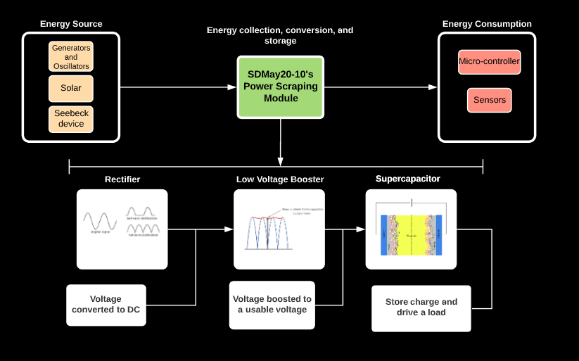
High Level Overview
Notes:
Ahmed

Slide 4
Market Survey
There is a huge demand for Low Power Power Harvesting Devices in fields like Medicine and Engineering Industry.
Most of these harvesting devices are used in hard to reach areas like:
Remote Control Monitoring Systems.
Implantable Devices.
Equipment Monitoring.
Notes:
Shahzaib.

Slide 5
Functional Requirements
Converting 1.1 V AC Peak to Peak Voltage to 3V DC.
The input signal is the only power source for the device.
Use a source or method that can be adjusted from 1.1 Vpp to 0.2 volts Vpp.
lowest possible input.
Include a charge indicator in the output of the device.
The entire device must be contained within a 6” by 6” space.
Notes:
Andesen

Slide 6
Technical Considerations and Constraints
Finding diodes that have low barrier voltage.
Use half-wave or full-wave rectifier accounting for voltage drop.
Finding a boosting device that can utilize a very low input and achieve 3V or greater
Determine necessary capacitance to allow for adequate charge time
Notes:
Benjamin

Slide 7
Potential Risks
Excessive signal loss during rectification
Using Schottky Diodes to reduce the impact of rectification on the already small input signal.
Slow Charging Capability
Enough power may not be available to charge the capacitor.
Booster Functionality Issues
Booster module may not work as specified from manufacturer
Input signal variability (RF-type signal, solar applications, etc)
May fluctuate due to the choice of source.
Notes:
Ben

Slide 8
Potential Mitigations
Test the parts rigorously before including them in the system.
Make sure that the signal generator can produce enough power.
Power limitations of the signal generators in Lab.
Design or order a better booster design
Order a large enough supercapacitor preferably 1 F.
Notes:
Ben

Slide 9
Resources & Cost Estimate
Prototype Cost:
Schottky Diodes.
EH 4295 Booster Module.
Supercapacitor.
Capacitors.
LED.
Total Cost:$72.32
Total Project Cost:
Two types of boosters tested.
Spare parts
Diodes.
Capacitors.
Boosters.
Misc. Circuit Components.
Total Cost: $295.95
Main resources provided by Iowa State University: Power Supply, Oscilloscope, and Multimeter
Notes:
Andesen

Slide 10
Project Milestones & Schedule
Semester 1
Researched Current Solutions
Preliminary Schematic.
Selected Initial Parts.
Component Testing.
Semester 2
Updated Design After Testing.
Looked into Booster Alternatives.
Selected New Booster Module.
Booster Testing.
System Testing.
Notes:
Andesen

Slide 11
DESIGN

Slide 12
Non-Functional Requirements
The system should be as efficient as possible.
Minimize loss.
Determine for every hour of energy scrapping, how many minutes will we be able to drive a 20mA LED.
Stretch goals:
Produce output of 5V
Use harvesting device as input
Scalability
Notes:
Jordan

Slide 13
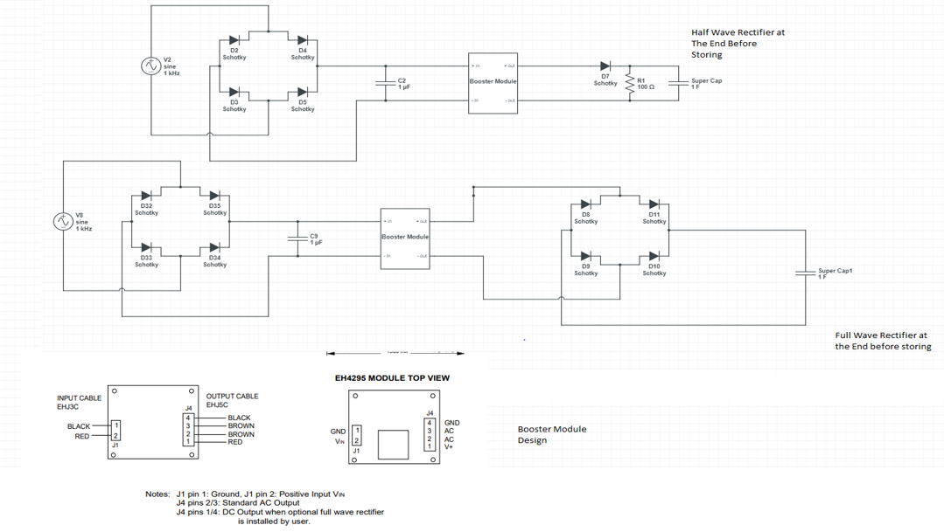
System Design
Notes:
Cao

Slide 14
Functional Decomposition
Rectification - Using Schottky diodes to convert the AC input signal into a DC signal.
Voltage Boosting - Using a DC-DC booster, increase the low-level input to a higher voltage level.
Energy Storage - Store the charge into a long-term storage component (supercapacitor) so that it can be used when desired.
Charge Indicator - Add an indicator (LED) to signal that the energy storage device is being charged.
Notes:
Ahmed

Slide 15
TESTING

Slide 16
Functional Test Plan
Component-Level
Diode
Verify cutoff voltage
Rectification test
Capacitor
Verify capacitance
Charge testing of capacitors
Booster
Verify boosting effect
System-Level
Output test
DC output
At least 3V
Function test
Power LED
Verify LED time vs charge time
Efficiency test
Energy out vs energy in
Notes:
Jordan

Slide 17
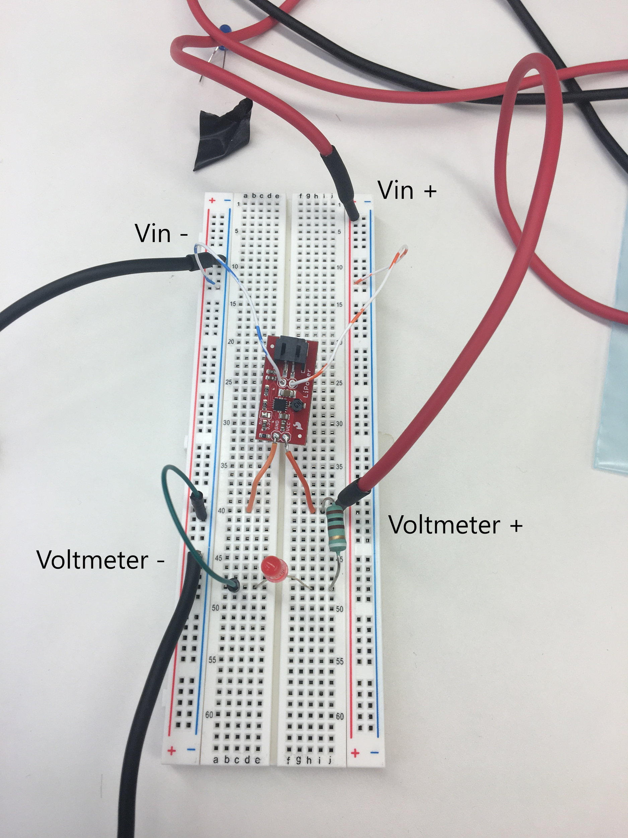
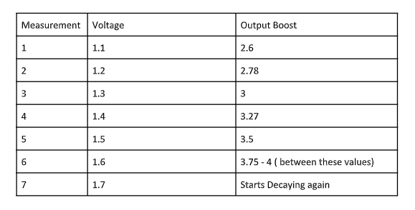
Booster Testing
In the booster testing stage we verified the functionality of the booster between 1.1V and 1.6V DC input. However the required input is below this range.
Notes:
shahzaib

Slide 18
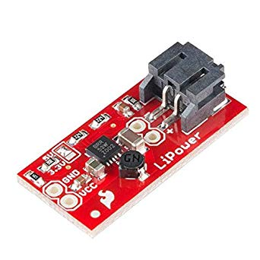
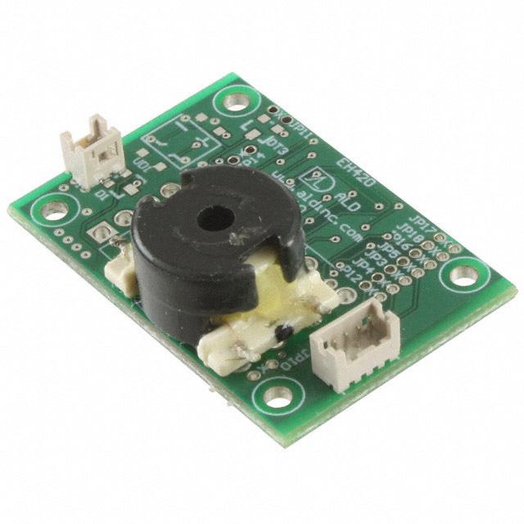
Voltage Boosters
Testing Yielded Several Issues:
Failure to hold boost.
Transient behavior.
Inconsistent results.
Transition To a New Booster:
Found EH-4295.
Better Voltage Boost.
Facilitates a Boost of 0.3V - 5V.
DC-DC Booster
DC-AC Booster
Notes:
shahzaib

Slide 19
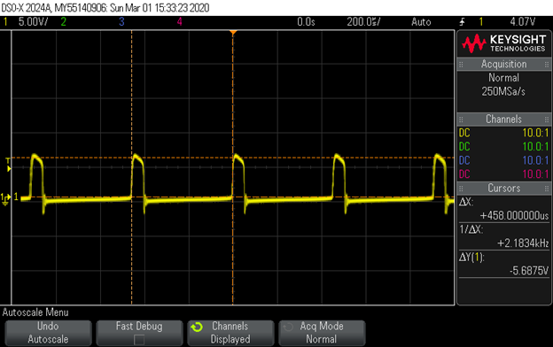
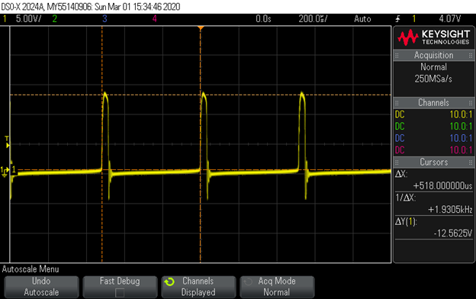
Booster Testing (EH4295)
DC power 0.35V, 10K ohms load.
DC power 0.5V, 10K ohms load.
Notes:
Shahzaib (Performance)

Slide 20
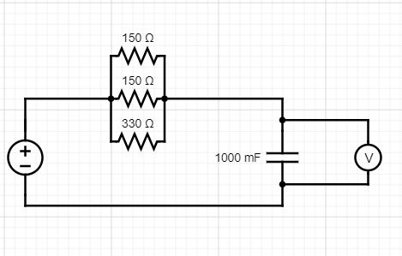
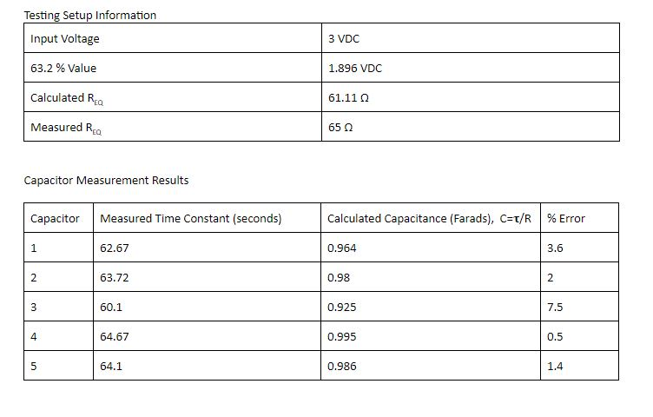
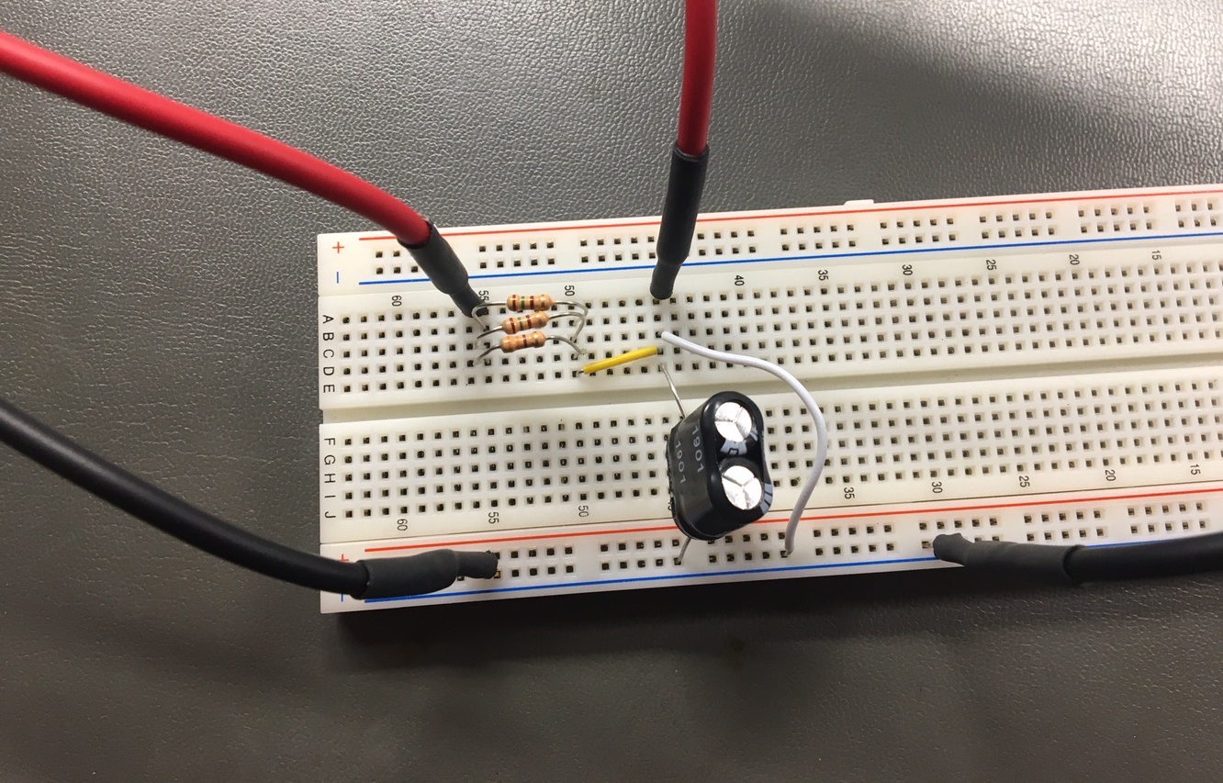
Capacitor Testing
The capacitors were tested with the circuits shown here.
From the results, they are acceptable for use in or design.
Notes:
ben

Slide 21
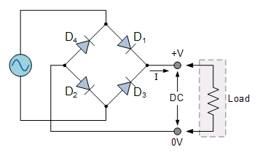
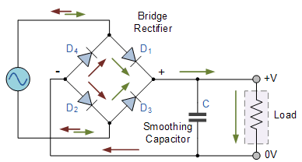
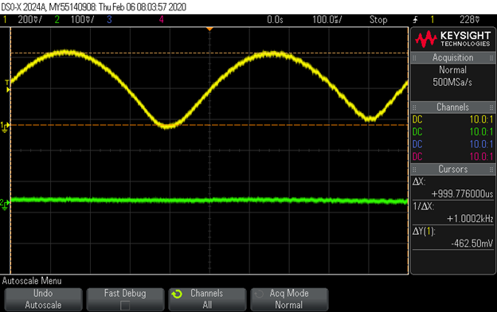
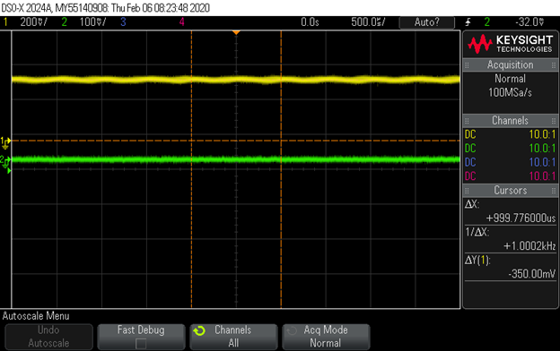
Rectification Circuit
When applied with 1.1Vpp, 1KHz sine wave with 10K load resistor.
When applied with 1.1Vpp, 1KHz sine wave with 10K load resistor and 20uF smoothing capacitor.
Notes:
cao

Slide 22
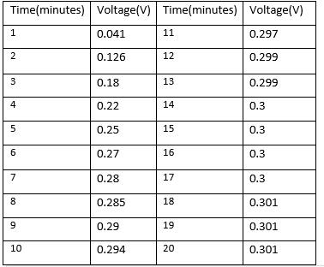
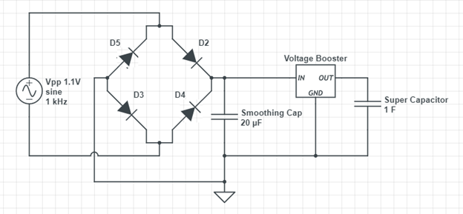
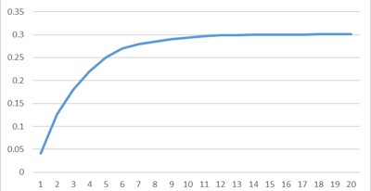
System Testing
According to the results we obtained we verified that the system was successfully charging the supercapacitor. However the speed is relevently slow the charging process saturates fast.
Volts(V)
Time (Mins)
Notes:
Cao

Slide 23
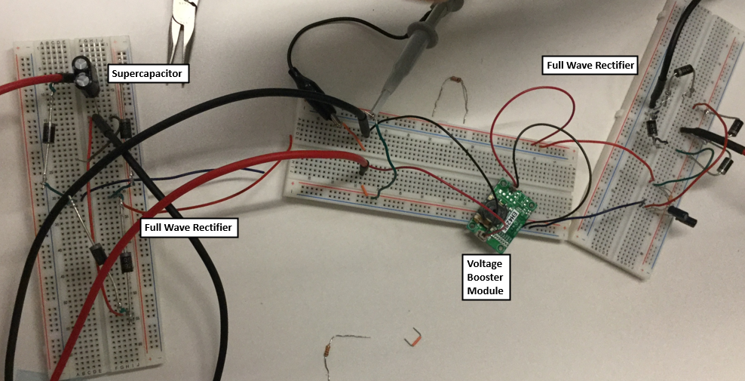
Prototype Board
Notes:
Ben

Slide 24
Engineering Standards and Design Practices
Cadence simulated circuit testing.
Readable circuit designs that follow design conventions.
RoHS compliant circuit components
Followed all electrical safety procedures.
IEEE Code of Ethics
Notes:
Shahzaib

Slide 25
Member Responsibilities
Shahzaib Shahid: Team Leader.
Benjamin Yoko: Chief Engineer.
Andesen Ande: Documentation Manager.
Ahmed Salem: Test Engineer.
Jordan Fox: Design Engineer.
Xiangyu Cao: Test Engineer.
Notes:
Jordan

Slide 26
Summary
Accomplished
Designed Energy Harvesting Unit Given Clients Constraints
Explored Alternative Methods and Parts
Component Testing
Began System Testing
Planned
Complete System Testing
Detailed Analysis of Circuit Performance
Explore Ways to Improve Performance
Strive for Stretch Goals
Notes:
Andesen

Slide 27
Thank You

